Slide 1
User Interfaces
Kay Kasemir
July 2026

Slide 2
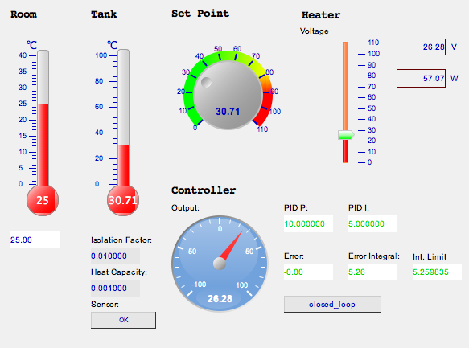
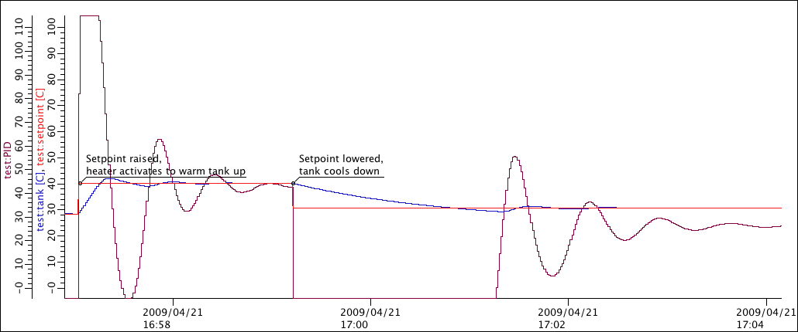
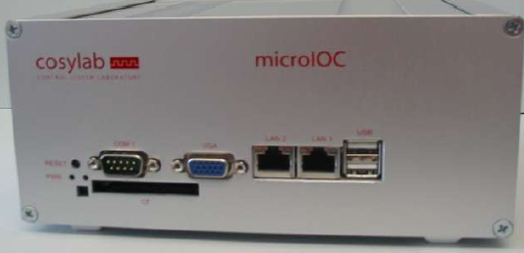
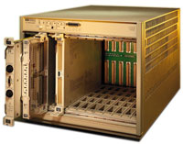
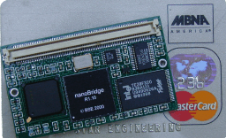
EPICS: Distributed System
Servers Clients
IOC
Display
IOC
Archive
IOC
Alarm Handler

Slide 3
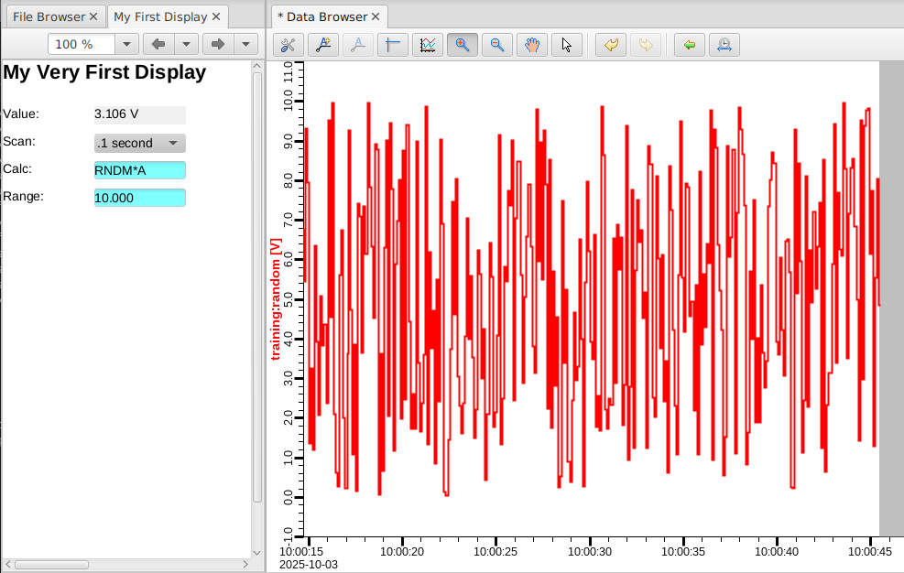
First Steps into the Deep End
Run 01_first_steps/very_first.db to get ‘training:random’
Start css
Open Applications, Utilities, File Browser
Right-click on 01_first_steps, New Display, “my_first”
Double-click “My Display”, type “My Very First Display”, enter
Change Label “Some Value:” into “Value:”
Change “<sim://sine>” PV into “training:random”
Push Run button
Change PREC and EGU fields of the PV
  Via ‘caput’ in terminal
  Via ‘dbpf’ in IOC shell
  Via ‘Probe’ in CSS
  Via text editor in very_first.db
Add Label “Scan:”
Add Combo Box for PV “training:random.SCAN”
Add Label and Text Entry for PV “training:random.CALC”
.. for “training:random.A”
Right-click on value in runtime and open Data Browser
Zoom/pan to show data
Right-click on section tab to “Split Left/Right”, arrange like this:

Slide 4
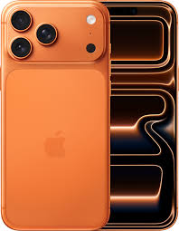
Over the years

Slide 5
What changes, what doesn’t?
Basic dial-by-number
Import “Contacts”, Name & Number
Custom dial tone, icons, .. in “Contacts”
Speed dial
Apps

Slide 6
Over the years
IOC
User Interface
Since ~1990:
record(ai, “my_record”)
{
field(DTYP, “MyDevice”)
field(INP , “@channel2”)
field(SCAN, “1 second”)
...
More supported platforms:
vxWorks, RTEMS, Linux, OS X, Windows, ..
68000, Intel, PPC, Arm, ..
edd/dm 198x
medm 199x
edm 200x
CS-Studio 201x
2009: BOY
2017: Display Builder
2019: Web Runtime
Also:
tcl/tk/ca,
python/qt/ca, ..
Limited compatibility.

Slide 7
“Program" vs. ”Display Manager”
Tcl/tk, Matlab, Delphy, Visual Basic, Python/Qt, … and CA/PVA client library
You can program sophisticated displays
Nobody else will understand and maintain your code
In 5..10 years, need to re-implement it all
Edd/dm, medm, dm2k, edm, CS-Studio *.opi,
CS-Studio *.bob
Use provided Widgets
  ‘Label’, ’Text Update’, …
Operators can easily tweak your displays or create new ones
In 5..10 years, there is hope for translating displays to a new tool

Slide 8
Limited Compatibility
MEDM
Text
{
object
{
x= 265
y= 440
width=155
height=20
}
"basic attribute”
{
clr=54
}
textix=”Hello"
}
EDM
object activeXTextClass
beginObjectProperties
x 265
y 440
w 155
h 20
font "arial-bold-r-10.0"
fgColor index 5
value {
”Hello"
}
endObjectProperties
Qt Designer
<widget class="caLabel" name="caLabel_0">
<property name="foreground">
<color alpha="255">
<red>10</red>
<green>0</green>
<blue>184</blue>
</color>
</property>
<property name="text">
<string>Hello</string>
</property>
<property name="geometry">
<rect>
<x>265</x>
<y>440</y>
<width>155</width>
<height>20</height>
</rect>
</property>
</widget>
Why not just
<text>Hello?
Dump of tool’s in-memory “model”.

Slide 9
General Format
<widget type="label">
<x>268</x>
<y>440</y>
<width>155</width>
<height>20</height>
<text>Hello<text>
<foreground_color>
<color red="0" green="0" blue="0”/>
</foreground_color>
</widget>
XML
  Somewhat human-readable
  Parsers for every programming language
“label”, “text_update”
  Not hinting at specific implementation
Display Builder

Slide 10
Example: ORNL/SNS
Accelerator
  EDM displays*
  CS-Studio Display Builder*
  CS-Studio Data Browser
  CS-Studio Alarms
  CS-Studio MPS Bypass Table
Beam Lines
  CS-Studio Display Builder*
  CS-Studio Data Browser
  CS-Studio Alarms
  CS-Studio Scan UI
* Web-EDM and Display Builder Web Runtime for read-only web access

Slide 11
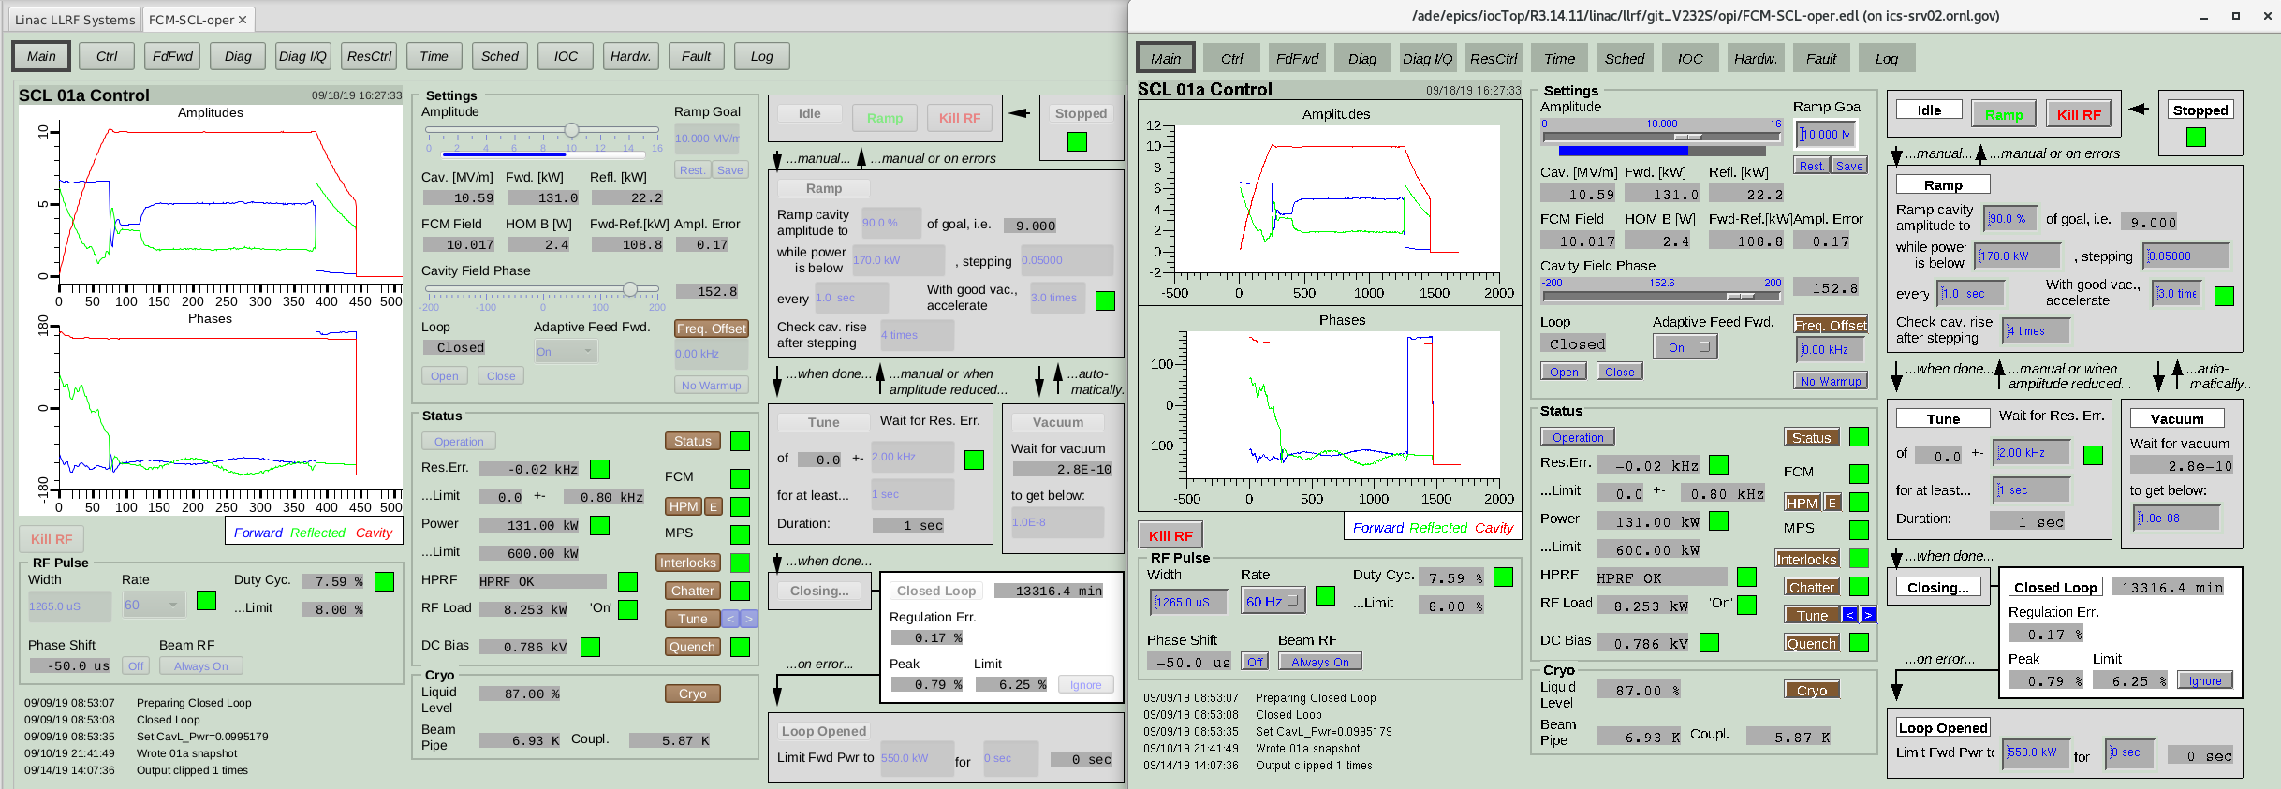
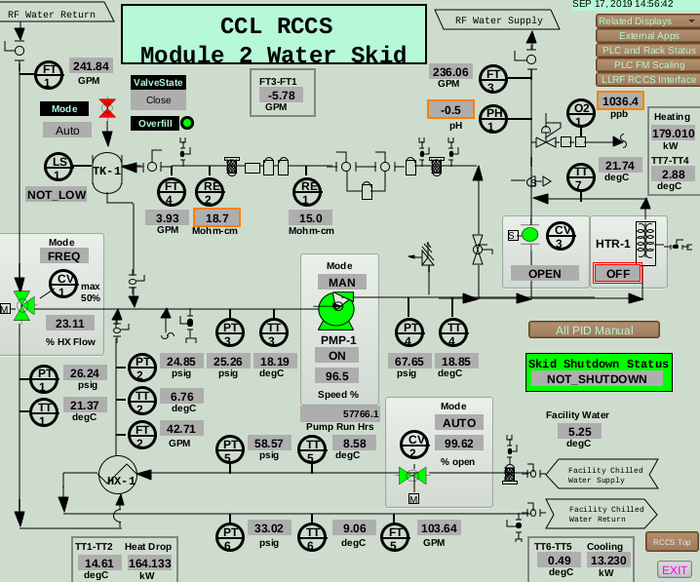
Conversions
EDM
Display Builder
Web Runtime
Web Runtime
EDM
CS-Studio Display Builder
Older
CS-Studio ‘*.opi’
MEDM
Largely automatic conversion of essential display content for files going back to 199x
manual or automatic
manual

Slide 12
Possible Approaches
Pick one tool and keep it
Stability
Eventually no more updates
Freeze OS?
Use today’s tool to the fullest, then update to next tool
All the new features
Need to re-implement displays
Use today’s tool carefully, then upgrade to compatible tool
Can use most displays for a long time
Need to re-implement some
Miss out on some features

